Slide 1
CS2030
Tutorial 5
jeremychoo@u.nus.edu
Only 3 questions! Probably a good thing cause this tutorial is ending soon…

Slide 2
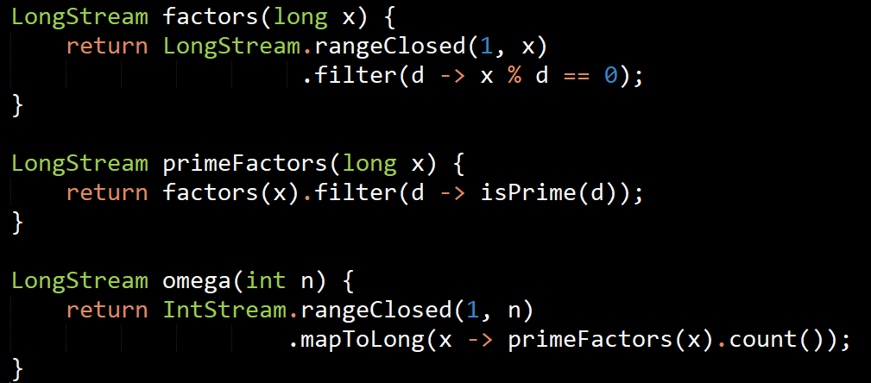
Question 1: Omega
Using Java Stream, write a method omega with signature LongStream omega(int n) that takes in an int n and return a LongStream containing the first n omega numbers.
The ith omega number is the number of distinct prime factors for the number i. The first 10 omega numbers are 0, 1, 1, 1, 1, 2, 1, 1, 1, 2.

Slide 3
Question 2: Combining streams
It’s first argument is a list that only contains elements of type T
Write a method product that takes in two List objects list1 and list2, and produce a Stream containing elements combining each element from list1 with every element from list2 using a BiFunction. This operation is similar to a Cartesian product.
public static <T,U,R> Stream<R> product(List<T> list1, List<U> list2, BiFunction<? super T, ? super U, R> f)
It’s return value is a Stream that contains R.
It’s second argument is a list that only contains elements of type U
This method defines 3 different classes that it will use: T, U, and R.
These can be anything.
It’s third argument is expected to be a function. The function will take in 2 arguments:
An element of type T or any of it’s superclass +
An element of type U or any of it’s superclass.
It should return an element of type R.

Slide 4
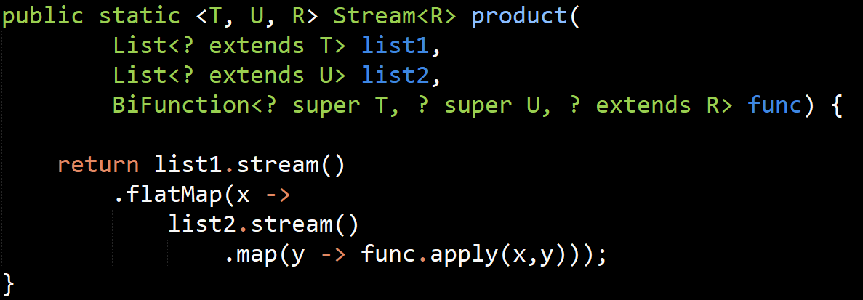
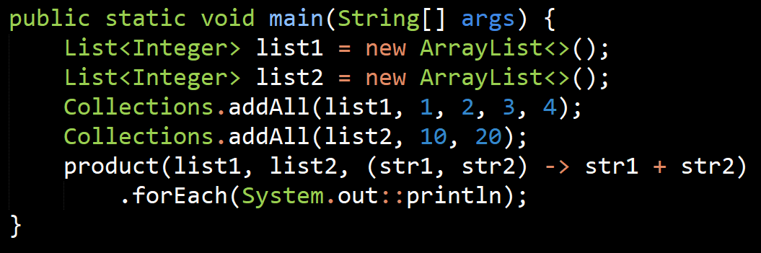
Question 2: Combining streams

Slide 5
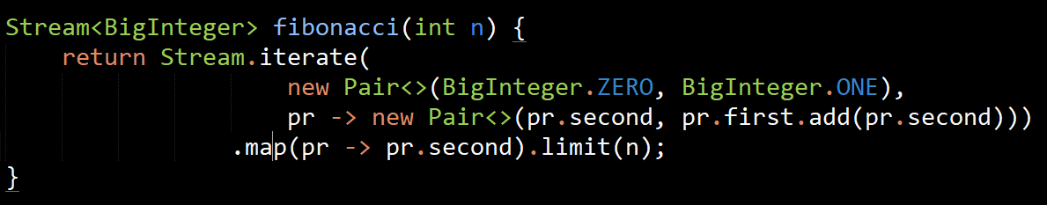
Question 3: Fibonacci
Write a method that returns the first n Fibonacci numbers as a Stream<BigInteger>. The BigInteger class is used to avoid overflow.
For instance, the first 10 Fibonacci numbers are 1, 1, 2, 3, 5, 8, 13, 21, 34, 55.

